Slide 1
WEEK # 5
The Academic Essay
Writing Process

Slide 2
The Essay
An essay is a written composition on a single topic or subject performing one of the following functions:
Usually, the academic essay is a written composition which treats the respective topic in a neutral & objective way.
Informing about a given topic
Describing something / Narrating something
Arguing against or in favour of something
Meditating on an idea or a feeling
Displaying feelings/emotions about something
Evaluating something, and so on

Slide 3
STANDARD ACADEMIC ESSAY:
It must contain 5 paragraphs and a maximum of 350 words
The first and the last paragraphs are designated to introducing and concluding the topic
The middle three paragraphs are reserved for the main body of an essay
Techniques of writing and the structure of paragraphs may differ in accordance with the type of the essay

Slide 4
Reading to Write:
Read the essays (61-64) and identify the central idea of each essay. Also, identify the main ideas/sub-topics and the supporting material used by the writers to elaborate the main ideas.

Slide 5
Essay 1: Losing Touch
Central idea: the inventions of modern technology seem to be cutting us off from contact with our fellow human beings
Main ideas/sub-topics:
The world of business is one area in which technology is isolating us
Another area that technology is changing is entertainment. Music, for instance, was once a group
Education is a third important area in which technology is separating us from others

Slide 6
Therefore, we can divide an essay into 3 major parts
Introduction
Background
Central Idea
Body Paragraphs
Main Points
Supporting details
Conclusion
Summarising
Restating Central Idea

Slide 7
The Process of Writing
Step 1: Assessing the writing situation:
The Topic: Focus on key words
The Purpose: Your aim behind writing (inform, persuade, argue, describe, evaluate, etc.)
Audience: Understand your readers (it guides you to select your material, vocabulary, style, and attitude).
Tone: The voice of the writer (depends on the audience, subject matter, purpose, and domain of writing).

Slide 8
Understanding the Topic
Here are some possible subjects for an essay (300 words). Mark each subject as ‘too broad’ or ‘about right’.
World war II
Nuclear power
Computers
The whooping crane’s struggle for survival
Pollution
The difficulties of living in one-parent family
Technology
Honesty
Marriage
Getting a job

Slide 9
Analysing titles
Be clear what the title is asking before starting to plan the essay
To identify the main requirements of the title
To determine the organization of the essay
For example:
Academic qualifications are of little practical benefit in the real world – Discuss
Discussing involves examining the benefits and drawbacks of something.
Relate the development of railways to the rise of nineteenth-century European nationalism.
Relate means to link one thing to another.

Slide 10
Activity
Underline the key words in the following titles and consider what they are asking you to do.
Define Information Technology (IT) and outline its main applications in medicine.
Compare and contrast the appeal process in the legal systems of Britain and the USA.
Evaluate the effect of mergers in the motor industry in the last ten years.
Trace the development of primary education in Britain. Illustrate some of the issues currently facing this sector.
Identify the main causes of rural poverty in China.
Calculate the likely change in coffee consumption that would result from a 10% fall in the price of coffee beans.
Classify the desert regions of Asia and suggest possible approaches to halting their spread.
Note: If a title has two or more key-terms, decide how much importance to give to each section of the essay (e.g. title (a) might demand 10% for the definition and 90% for the outline).

Slide 11
Activity
Match the terms to the definitions on the right
Analyse Give a clear and simple account
Describe Make a proposal and support it
Examine Deal with a complex subject by giving the
main points
State Divide into sections and discuss each critically
Suggest Give a detailed account
Summarise Look at the various parts and their relationships

Slide 12
Answers
Analyse: Divide into sections and discuss each critically
Describe: Give a detailed account
Examine: Look at the various parts and their relationships
State: Give a clear and simple account
Suggest: Make a proposal and support it
Summarise: Deal with a complex subject by giving the main points
Analyse means to inspect critically while examine is to observe carefully

Slide 13
Purpose of Writing
Aim behind writing: to inform, persuade, argue, describe, narrate, compare and contrast, analyze, evaluate, etc
Activity is on pg.# 70-71

Slide 14
Home task is on pg. #72

Slide 15
Audience Analysis
Clearly analyze and understand your readers. (as in age, background, gender)
This is important in guiding you in your selection of material, your vocabulary, your style, and attitude.
Activity is on pg# 73

Slide 16
Activity 2: Let’s read two paragraphs taken from different essays and articles. Read and decide who the target audience is in each case.
.
Plagiarism is the fraudulent representation of another person's language, thoughts, ideas, or expressions as one's own original work. Although precise definitions vary depending on the institution, in many countries and cultures plagiarism is considered a violation of academic integrity and journalistic ethics, as well as social norms around learning, teaching, research, fairness, respect, and responsibility. As such, a person or entity that is determined to have committed plagiarism is often subject to various punishments or sanctions, such as suspension, expulsion from school or work, fines, imprisonment, and other penalties.

Slide 17
It's important to know what plagiarism is, and what form it takes (some common types of plagiarism are listed here). It's also important to know how plagiarism happens. The final step is to develop effective academic skills. Many students who plagiarise do so unintentionally, often because they don't have the academic skills to avoid over-reliance on the work of others or because they aren't sure what constitutes plagiarism. So it's important to take every opportunity to develop your academic skills.

Slide 18
Tone
Based on your topic, purpose, audience, and domain of writing, tone will be decided.

Slide 19
Step 2: Planning (Pre-Writing):
First, plan your writing. Following things are done in the planning stage:
Generating ideas: you can use the following techniques to come up with ideas:
Brainstorming(pg. 74): Jot down all the ideas that come to your mind ignoring issues like relevance or importance of ideas and points. Scan your brain for any prior knowledge you have about the topic. (Clustering involves more focused thinking).

Slide 20
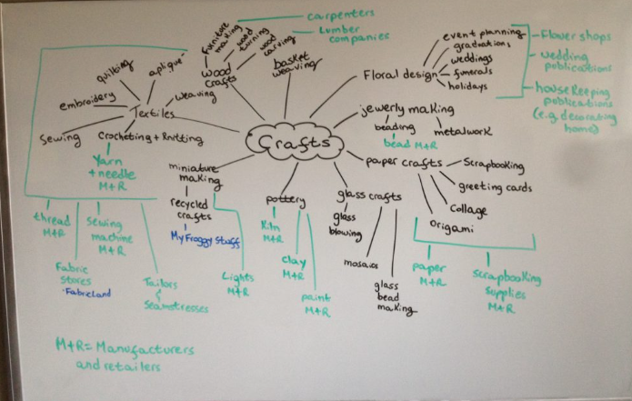
Methods of Brainstorming:
Mindmaping:This technique involves identifying a central topic (often represented as an image) and creating branches indicating the relevant categories that are related to the central topic extending radially from the central idea (Budd, 2004)

Slide 21
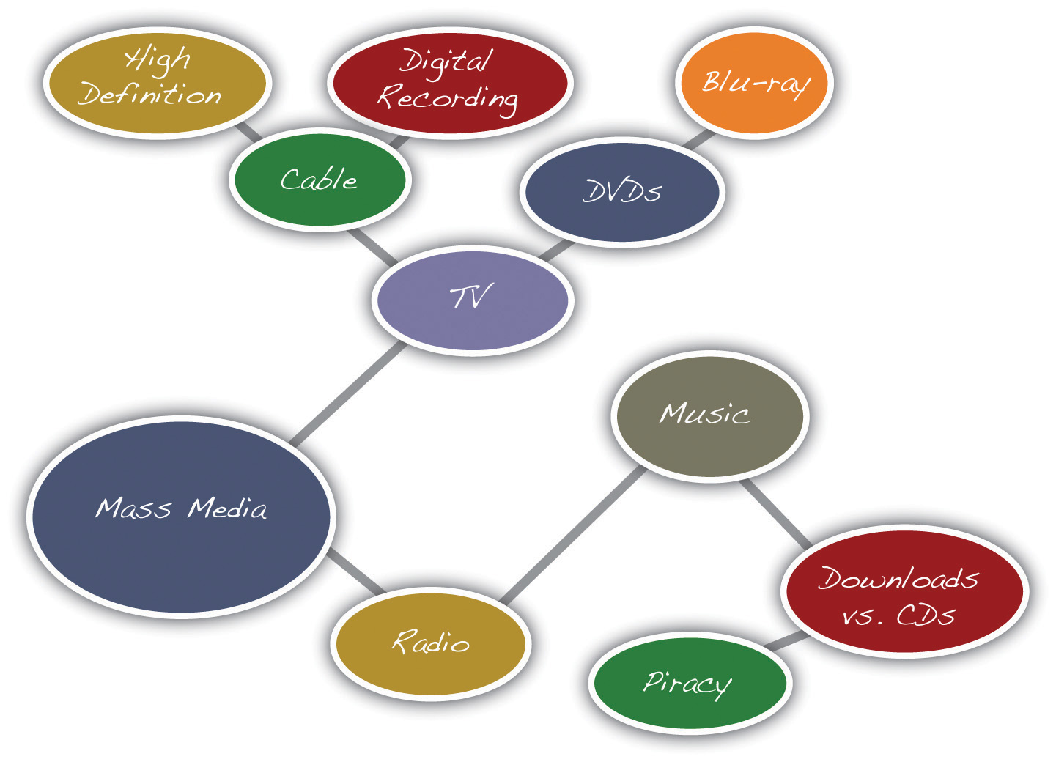
Methods of Brainstorming:
Clustering(pg. 75): Clustering involves more focused thinking.

Slide 22
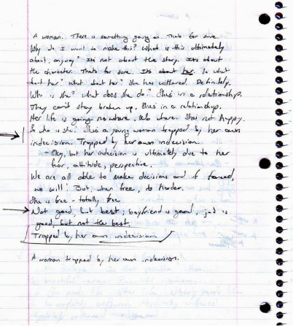
Methods of Brainstorming:
Free writing: It is to practice writing in general. Used as a preliminary to more formal writing. It involves continuous writing, usually for predetermined period of time.

Slide 23
Discussion: Discussion can also be very helpful in generating ideas. Jot down the ideas in a notebook. Scan and review your ideas. Select the most relevant and important ones and decide for a logical order. Other than this, you can search for ideas by reading books on the essay topic, or surf the net. Skim and scan sites or books.
Then, organize them into an outline for your essay by arranging them in a logical order.
Once you have a rough outline containing ideas for your essay, it is time to move on to the next step of the writing process.

Slide 24
Step 3: Reading:
After planning, reading is done.
It helps in getting more ideas, vocabulary, sentence structures, etc.
Add the new information in your outline.
Revise and finalize it.

Slide 25
Step 4: Rough Writing:
Once you have a final outline, write a rough draft ignoring grammatical and organizational concerns.
Most writers find beginning with the introduction paragraph difficult. So, they begin with the main body of the essay, and then write an introduction paragraph.
Your outline and ideas undergo considerable revision at this stage.
After having written the rough draft, it is now time to bring into consideration the issues you ignored in order not to disturb a spontaneous flow of ideas.

Slide 26
Step 5: Proofreading/Editing/Revising:
Check your essay for grammatical, structural and organizational mistakes, unity and coherence, etc.
Step 6: Final Draft Writing:
After proofreading and editing, write a final draft of your essay.

Slide 27
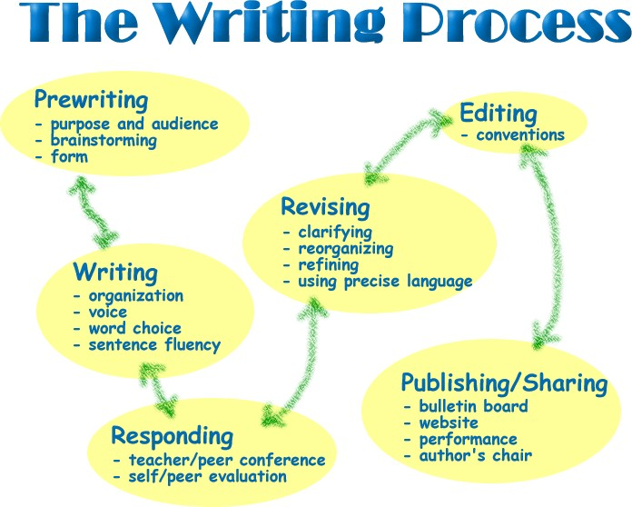

Slide 28
Thank you ☺
The
END!

